Slide 1
St. Louis Central Corridor West Building Permits
Monthly Report: March 2022

Slide 2
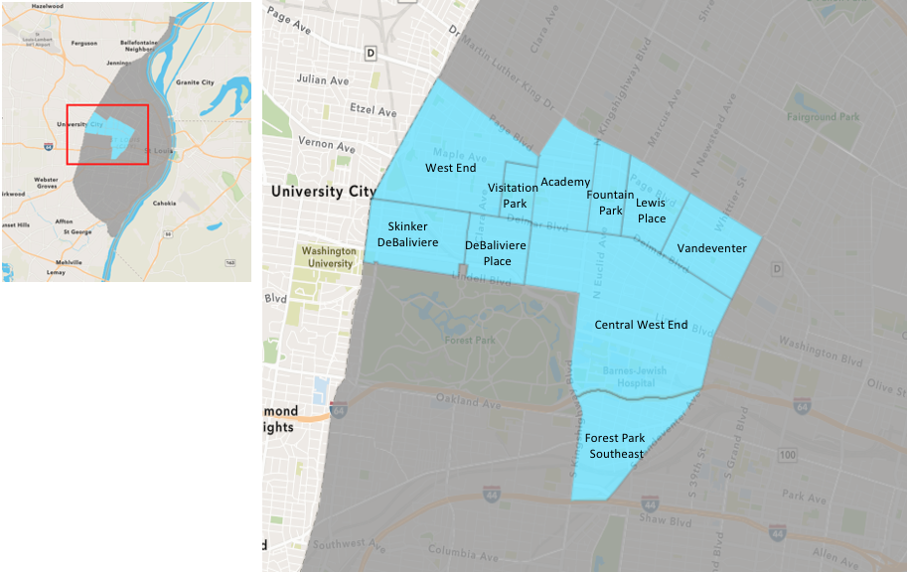
St. Louis Neighborhood Spatial Reference

Slide 3
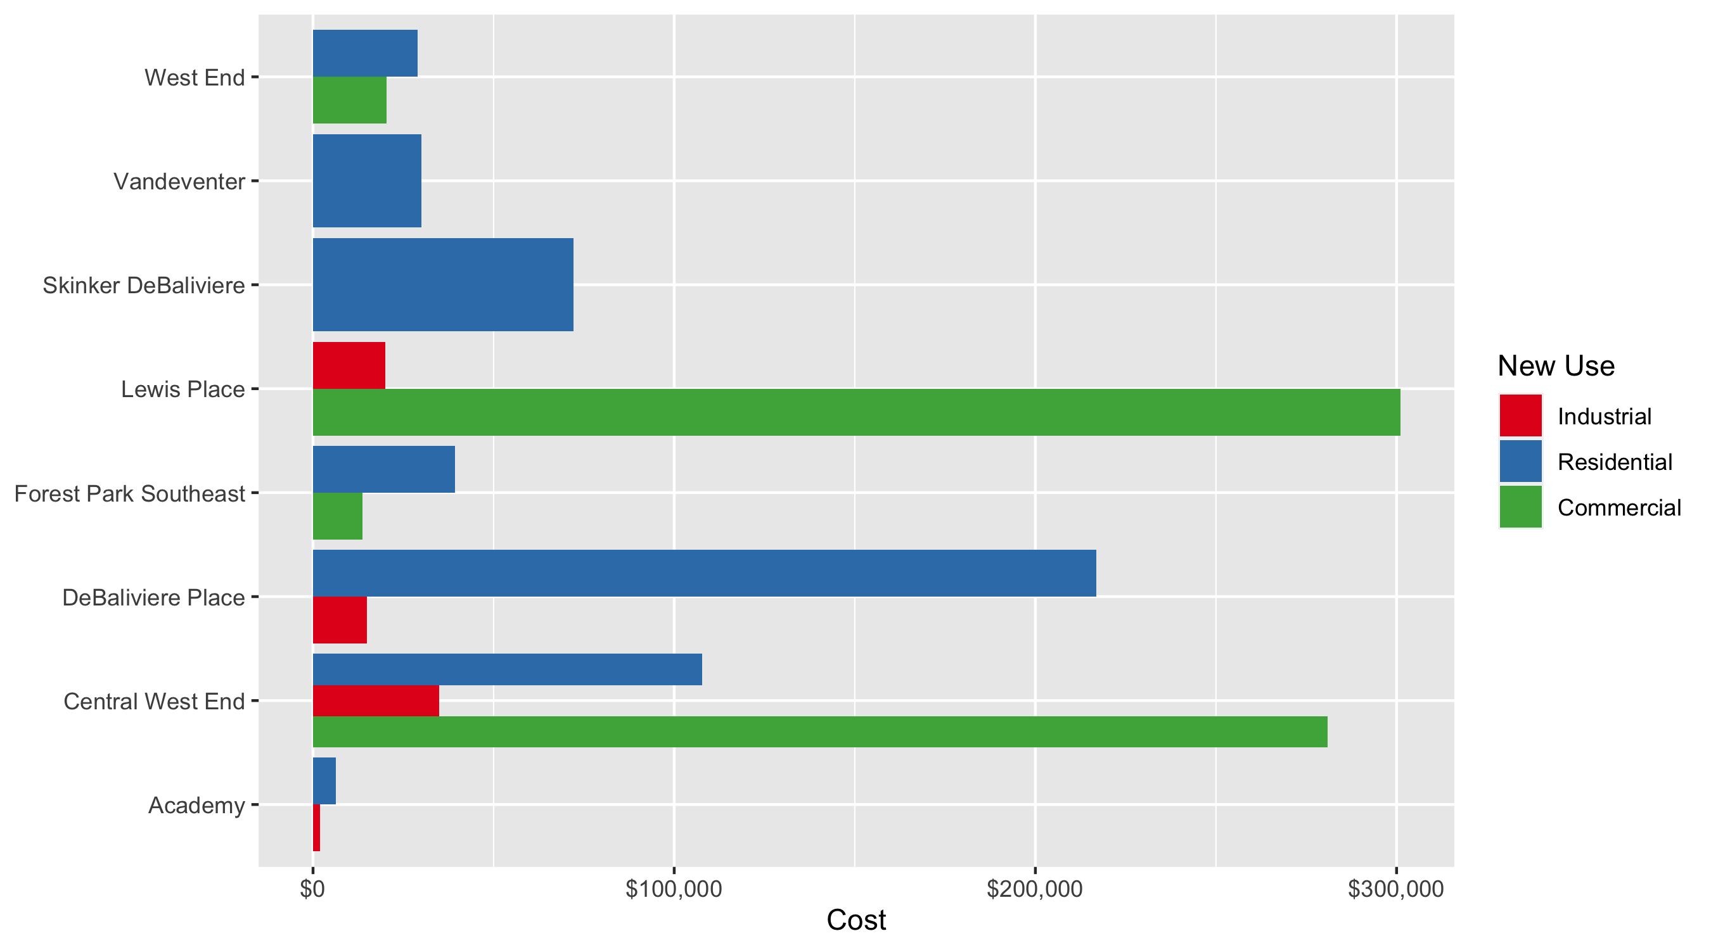
Neighborhood Summary: Average Building Permit Cost

Slide 4
Neighborhood Summary
March 2022 | March 2022 | March 2022 | March 2022
Neighborhood | Average Cost | # of Permits | Total Value of Permits
Academy | $4,833.333 | 3 | $14,500
Central West End | $192,615.197 | 44 | $8,475,069
DeBaliviere Place | $183,167.833 | 6 | $1,099,007
Forest Park Southeast | $35,955.133 | 15 | $539,327
Fountain Park | $0.000 | 0 | $0
Lewis Place | $160,509.500 | 2 | $321,019
Skinker DeBaliviere | $72,169.000 | 5 | $360,845
Vandeventer | $30,000.000 | 1 | $30,000
Visitation Park | $0.000 | 0 | $0
West End | $24,633.500 | 8 | $197,068
Last 6 Months | Last 6 Months | Last 6 Months | Last 6 Months
Neighborhood | Average Cost | # of Permits | Total Value of Permits
Academy | $42,626.50 | 24 | $1,023,036
Central West End | $484,002.55 | 232 | $112,288,591
DeBaliviere Place | $88,882.69 | 26 | $2,310,950
Forest Park Southeast | $59,612.79 | 90 | $5,365,151
Fountain Park | $31,142.86 | 7 | $218,000
Lewis Place | $45,301.46 | 13 | $588,919
Skinker DeBaliviere | $260,867.57 | 44 | $11,478,173
Vandeventer | $593,996.53 | 15 | $8,909,948
Visitation Park | $42,475.00 | 4 | $169,900
West End | $92,682.67 | 94 | $8,712,171

Slide 5
Core Neighborhoods

Slide 6
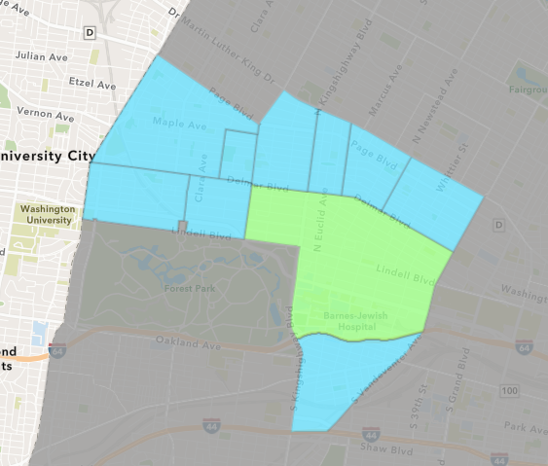
Central West End
March 2022 Neighborhood Cost Breakdown
Mean: $192,615
Median: $22,966
Range: $800 - $1,659,000

Slide 7
Central West End: Summary Notes
44 building permits in March 2022
12.82% change compared to March 2021 (39 total building permits)
$192,615: Average building permit cost in March 2022
-90.77% change compared to March 2021 ($2,087,093)
95 total building permits in 2022
-7.77% change YTD compared to this time in 2021 (103 total building permits)
$582,528: YTD average building permit cost in 2022
-30.23% change YTD compared to this time in 2021 ($834,968)

Slide 8
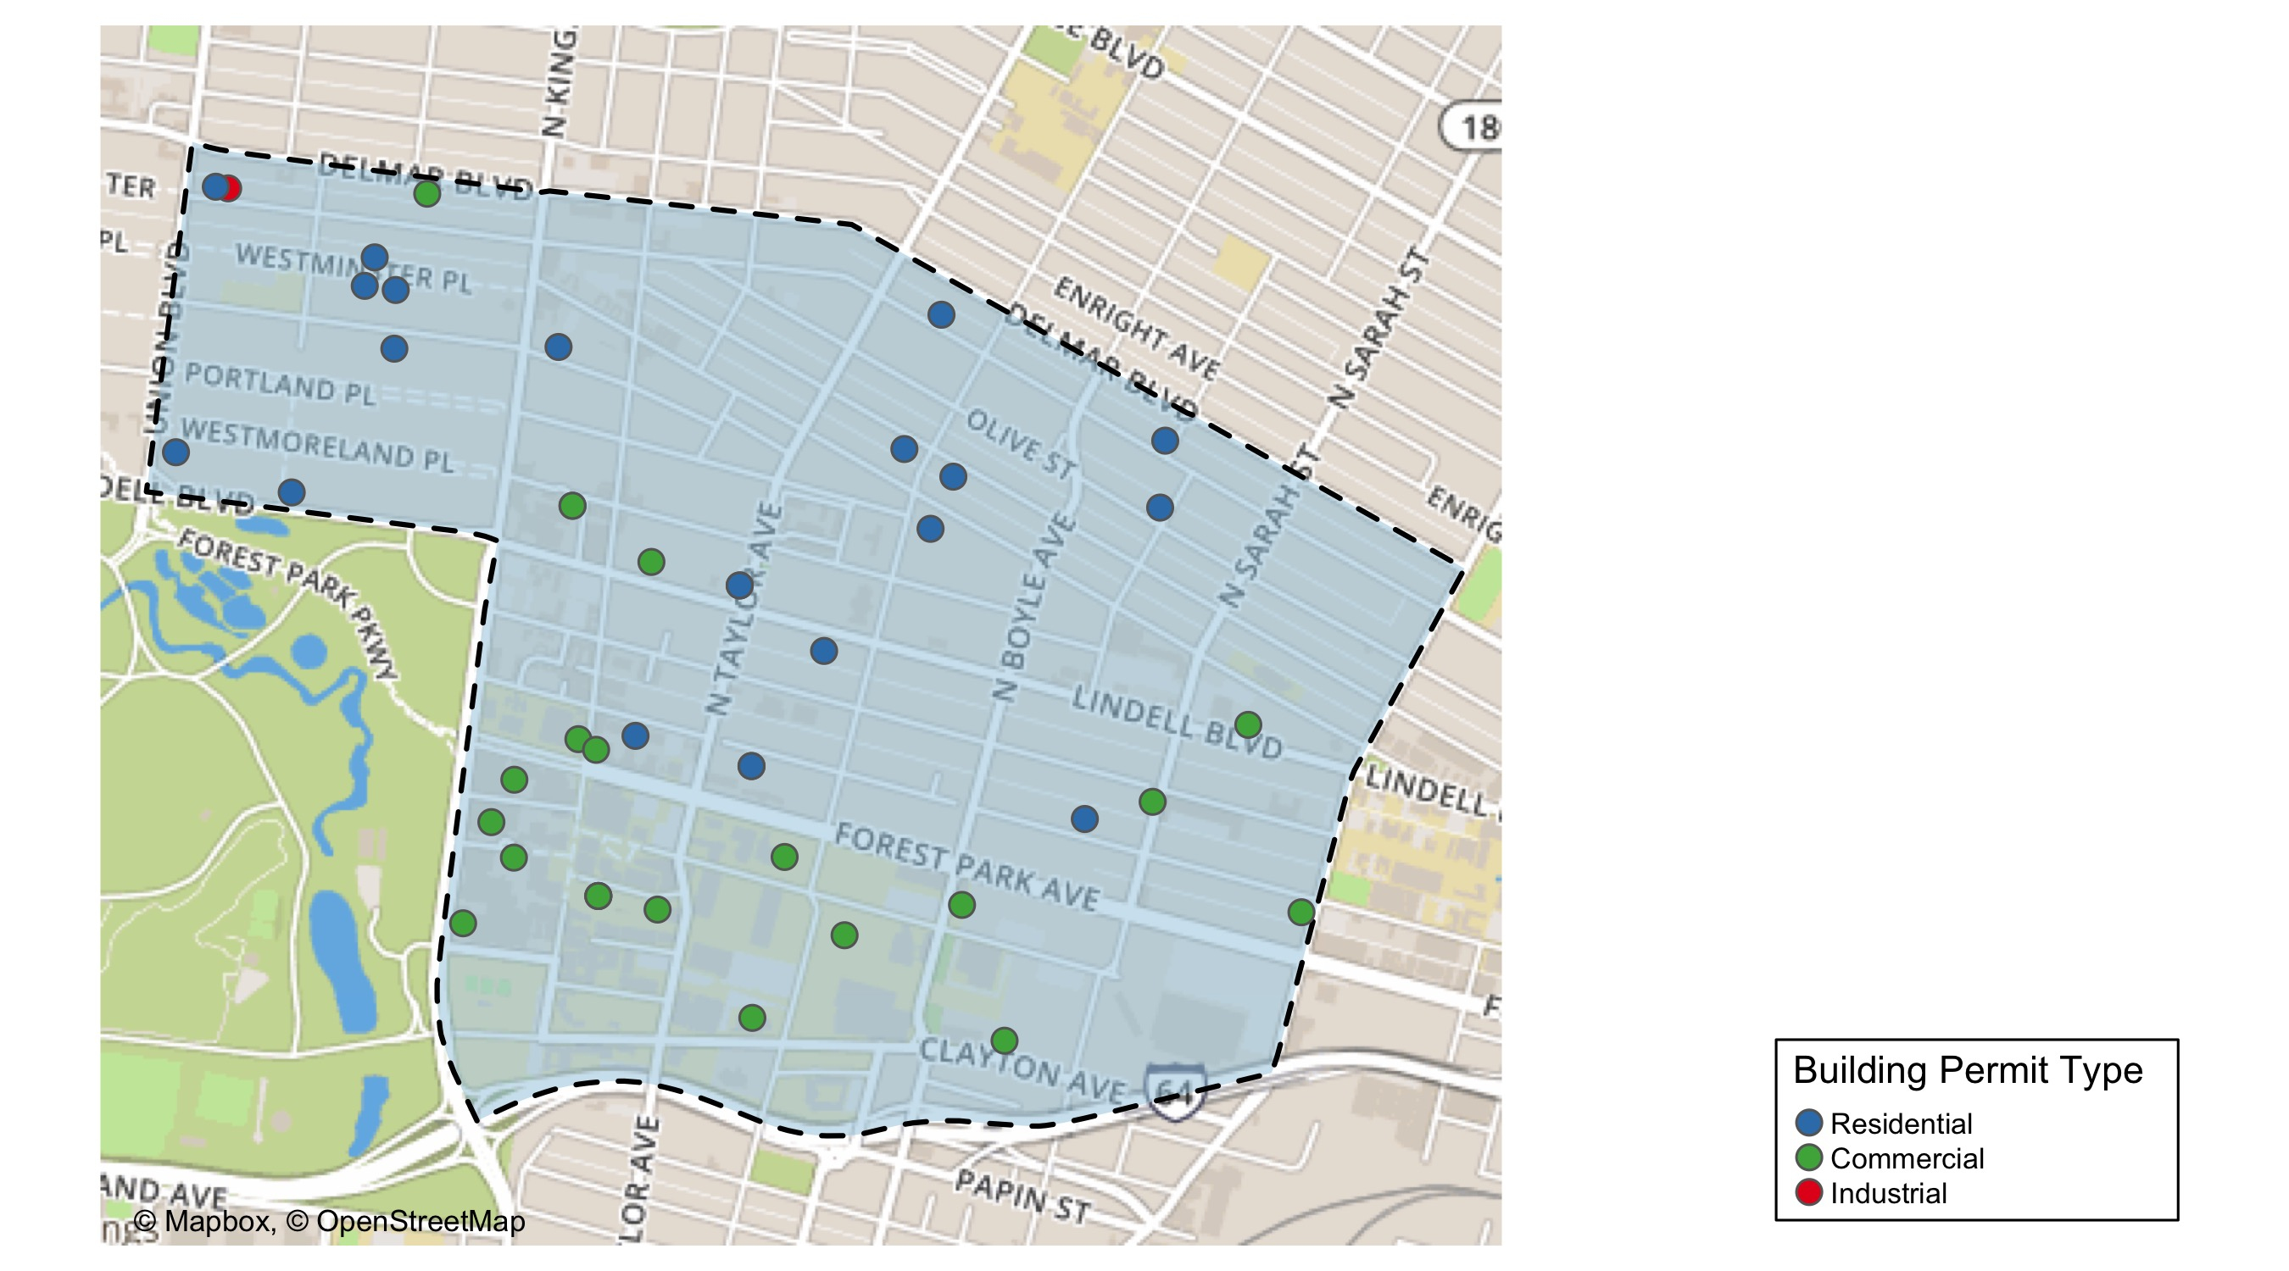
Central West End

Slide 9
Neighborhood Summary
March 2022 | March 2022 | March 2022 | March 2022
Permit Use | Average Cost | # of Permits | Total Value of Permits
Commercial | $280,821.3 | 22 | $6,178,069
Industrial | $35,000.0 | 1 | $35,000
Residential | $107,714.3 | 21 | $2,262,000
Last 6 Months | Last 6 Months | Last 6 Months | Last 6 Months
Permit Use | Average Cost | # of Permits | Total Value of Permits
Commercial | $959,538.18 | 99 | $94,994,280
Industrial | $48,121.43 | 14 | $673,700
Residential | $139,669.00 | 119 | $16,620,611

Slide 10
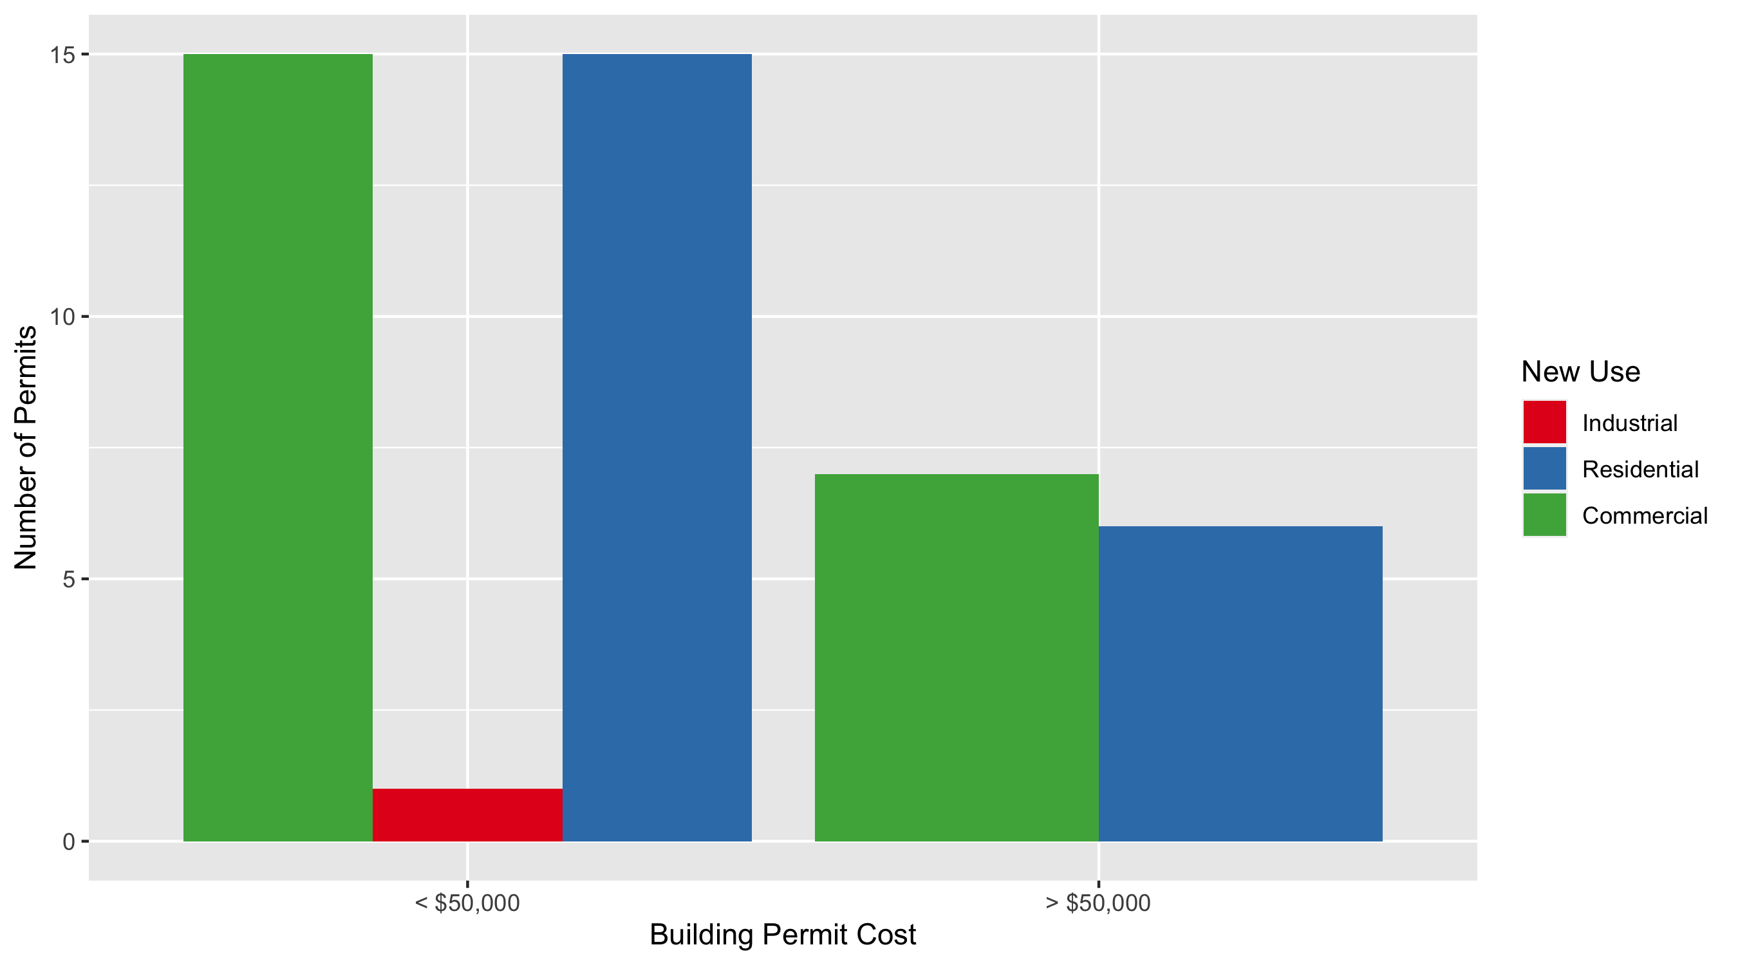
Central West End Permit Cost Breakdown

Slide 11
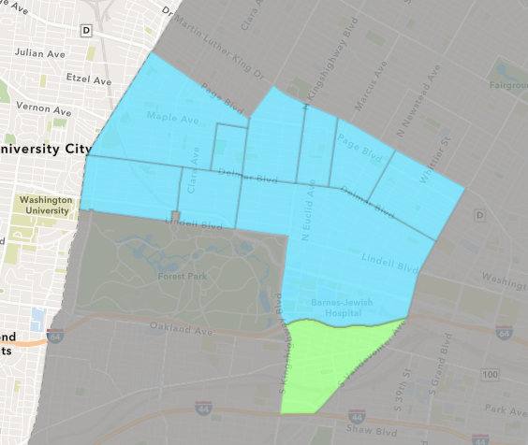
Forest Park Southeast
March 2022 Neighborhood Cost Breakdown
Mean: $35,955
Median: $12,000
Range: $100 - $320,000

Slide 12
Forest Park Southeast: Summary Notes
15 building permits in March 2022
-28.57% change compared to March 2021 (21 total building permits)
$35,955: Average building permit cost in March 2022
-98.24% change compared to March 2021 ($2,038,621)
37 total building permits in 2022
-9.76% change YTD compared to this time in 2021 (41 total building permits)
$105,179: YTD average building permit cost in 2022
-90.34% change YTD compared to this time in 2021 ($1,088,590)

Slide 13
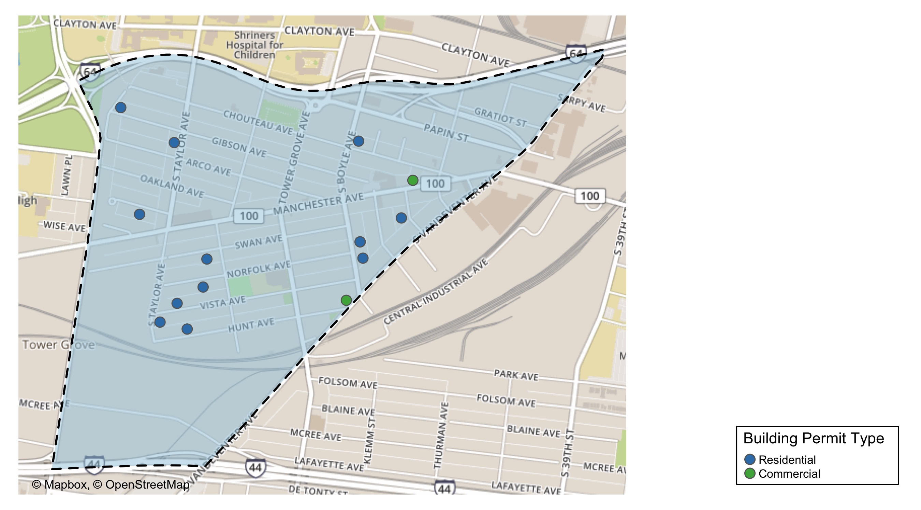
Forest Park Southeast

Slide 14
Neighborhood Summary
March 2022 | March 2022 | March 2022 | March 2022
Permit Use | Average Cost | # of Permits | Total Value of Permits
Commercial | $13,750.00 | 2 | $27,500
Industrial | $0.00 | 0 | $0
Residential | $39,371.31 | 13 | $511,827
Last 6 Months | Last 6 Months | Last 6 Months | Last 6 Months
Permit Use | Average Cost | # of Permits | Total Value of Permits
Commercial | $200,727.8 | 18 | $3,613,101
Industrial | $13,680.0 | 5 | $68,400
Residential | $25,129.1 | 67 | $1,683,650

Slide 15
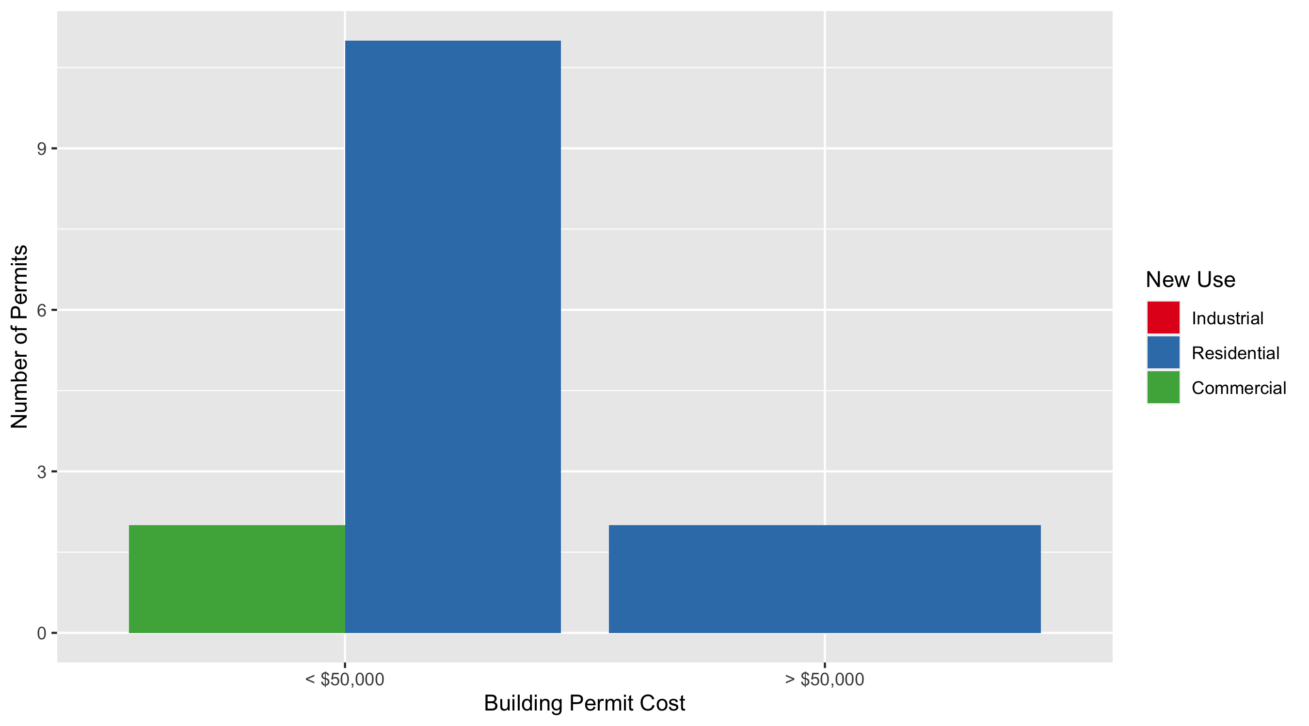
Forest Park Southeast Permit Cost Breakdown

Slide 16
Expanded Service Area

Slide 17
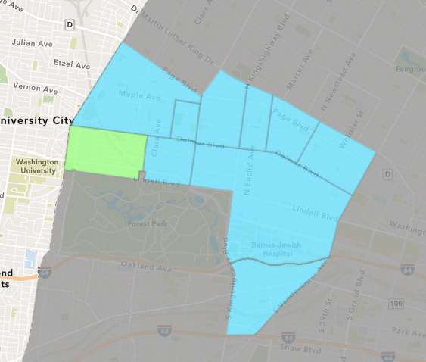
Skinker DeBaliviere
March 2022 Neighborhood Cost Breakdown
Mean: $72,169
Median: $61,360
Range: $5,400 - $210,000

Slide 18
Skinker DeBaliviere: Summary Notes
5 building permits in March 2022
0.00% change compared to March 2021 (5 total building permits)
$72,169: Average building permit cost in March 2022
12.76% change compared to March 2021 ($64,002)
19 total building permits in 2022
-13.64% change YTD compared to this time in 2021 (22 total building permits)
$273,825: YTD average building permit cost in 2022
560.42% change YTD compared to this time in 2021 ($41,462)

Slide 19
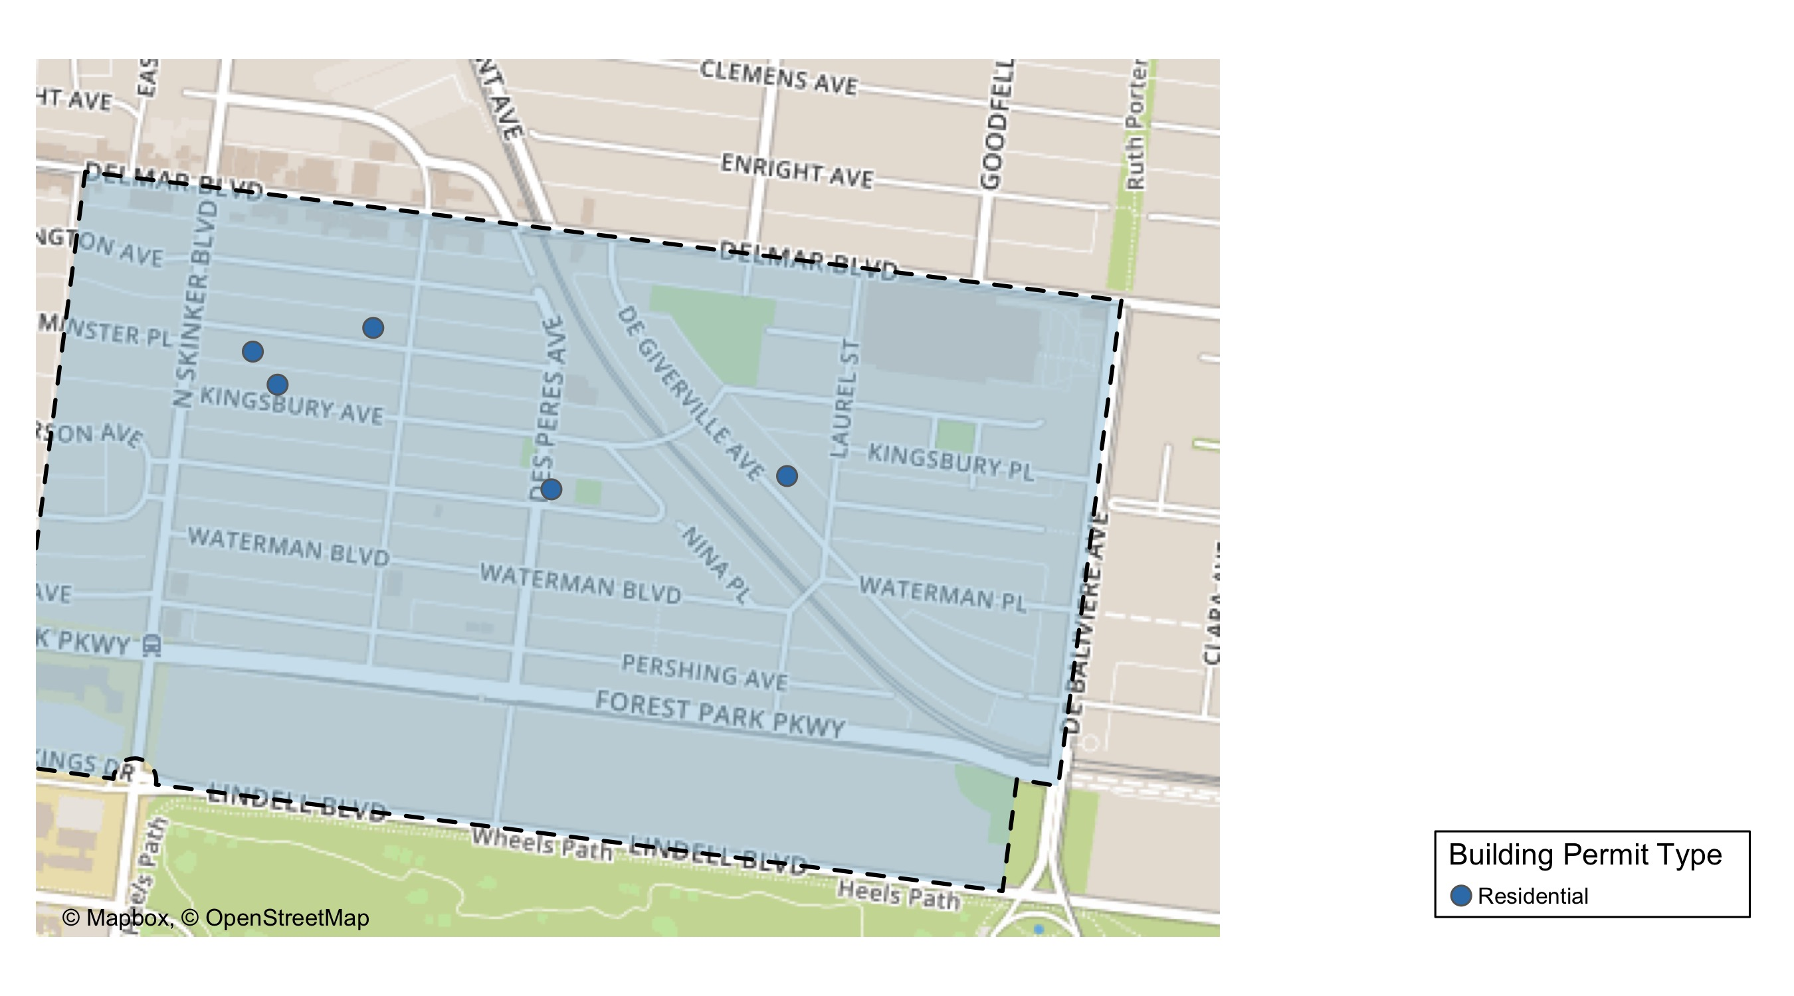
Skinker DeBaliviere

Slide 20
Neighborhood Summary
March 2022 | March 2022 | March 2022 | March 2022
Permit Use | Average Cost | # of Permits | Total Value of Permits
Commercial | $0 | 0 | $0
Industrial | $0 | 0 | $0
Residential | $72,169 | 5 | $360,845
Last 6 Months | Last 6 Months | Last 6 Months | Last 6 Months
Permit Use | Average Cost | # of Permits | Total Value of Permits
Commercial | $599,067.9 | 7 | $4,193,475
Industrial | $26,375.0 | 4 | $105,500
Residential | $217,551.5 | 33 | $7,179,198

Slide 21
Skinker DeBaliviere Individual Permit Breakdown
Neighborhood | Owner | New Use | Cost | address
Skinker DeBaliviere | K C ELLIOTT LLC | Residential | $210,000 | 6117 WESTMINSTER PL
Skinker DeBaliviere | STAHL, MICHAEL | Residential | $61,360 | 6172 WESTMINSTER PL
Skinker DeBaliviere | BUILDER LLC | Residential | $19,085 | 5955 MCPHERSON AV
Skinker DeBaliviere | TUNSTALL, LEROY LAMAR & | Residential | $5,400 | 5829 DEGIVERVILLE AV
Skinker DeBaliviere | GAVIN, RYAN J & DEANNE N HARRIS | Residential | $65,000 | 6161 KINGSBURY AV

Slide 22
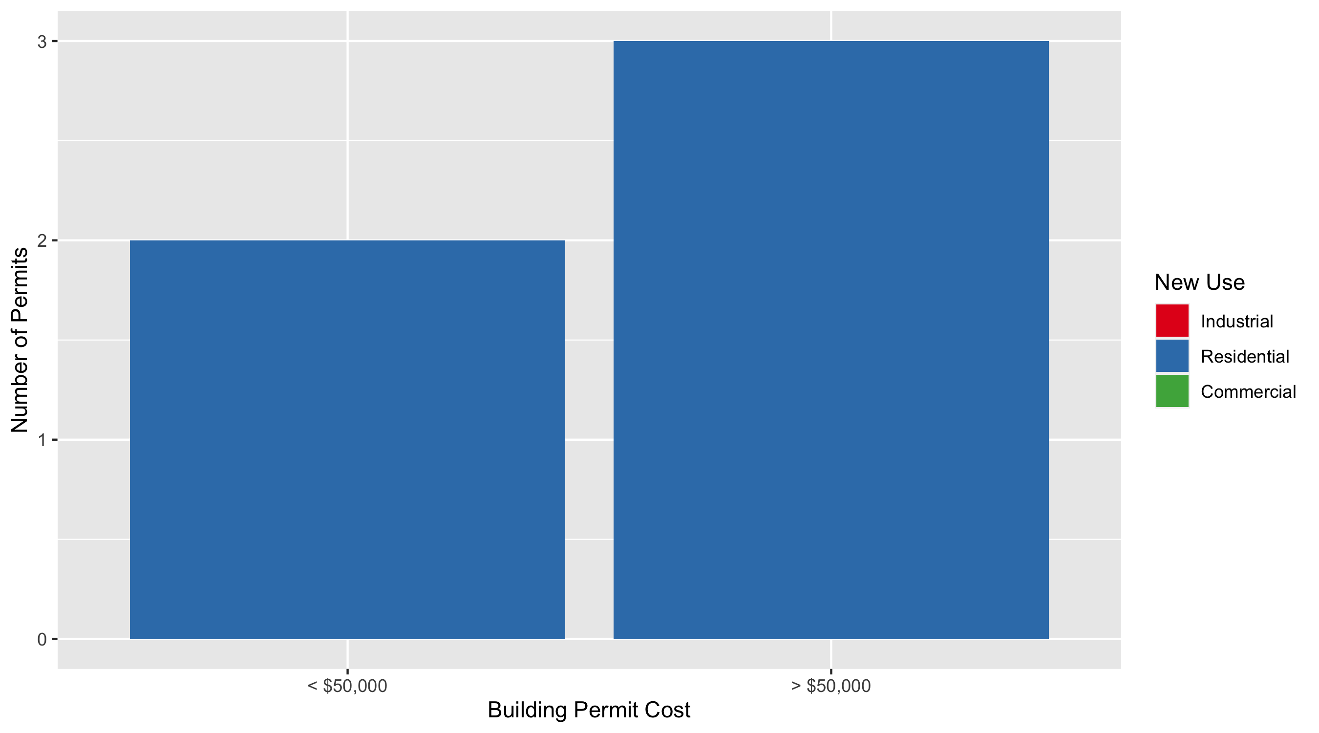
Skinker DeBaliviere Permit Cost Breakdown

Slide 23
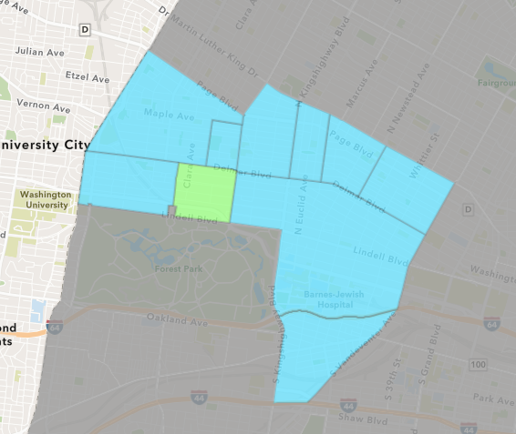
DeBaliviere Place
March 2022 Neighborhood Cost Breakdown
Mean: $183,168
Median: $90,000
Range: $15,000 - $749,007

Slide 24
DeBaliviere Place: Summary Notes
6 building permits in March 2022
100.00% change compared to March 2021 (3 total building permits)
$183,168: Average building permit cost in March 2022
20.28% change compared to March 2021 ($152,283)
10 total building permits in 2022
-37.50% change YTD compared to this time in 2021 (16 total building permits)
$117,156: YTD average building permit cost in 2022
46.63% change YTD compared to this time in 2021 ($79,900)

Slide 25
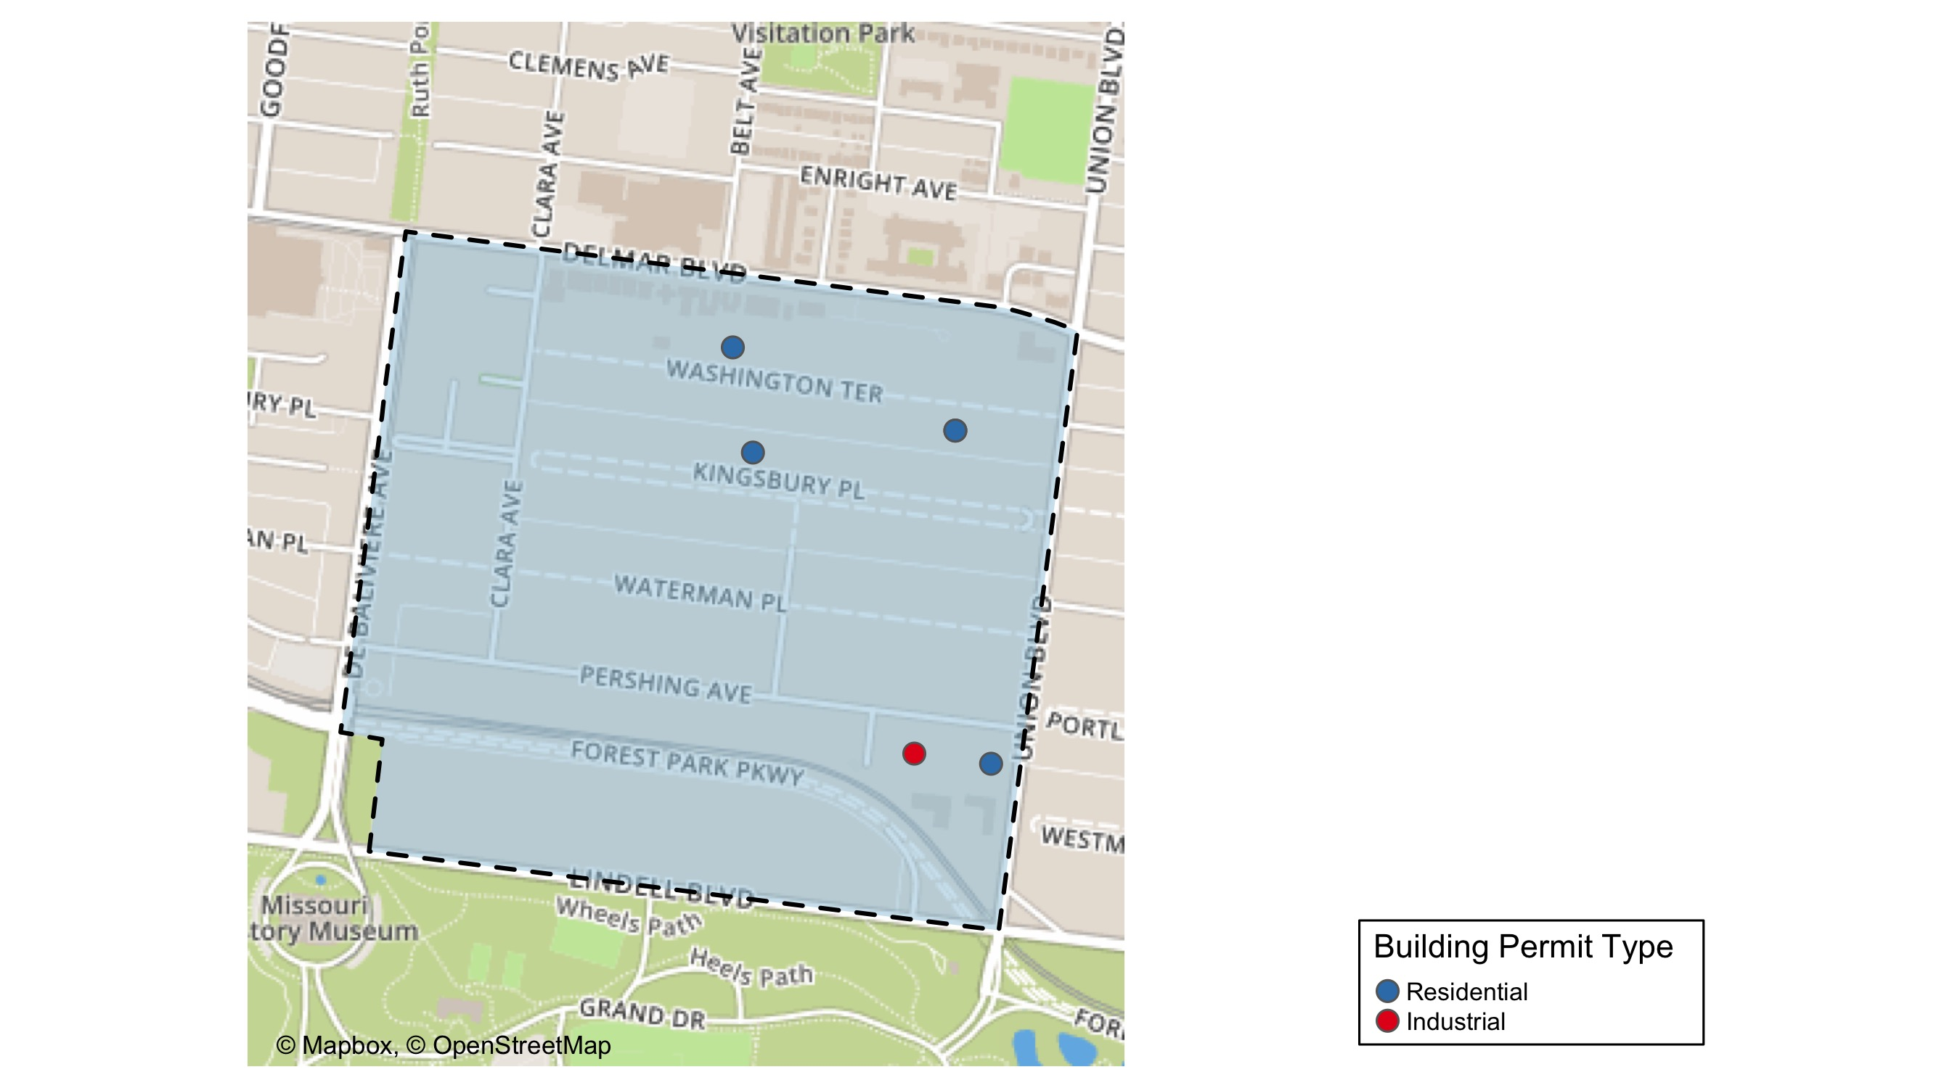
DeBaliviere Place

Slide 26
Neighborhood Summary
March 2022 | March 2022 | March 2022 | March 2022
Permit Use | Average Cost | # of Permits | Total Value of Permits
Commercial | $0.0 | 0 | $0
Industrial | $15,000.0 | 1 | $15,000
Residential | $216,801.4 | 5 | $1,084,007
Last 6 Months | Last 6 Months | Last 6 Months | Last 6 Months
Permit Use | Average Cost | # of Permits | Total Value of Permits
Commercial | $26,250.0 | 2 | $52,500
Industrial | $22,500.0 | 2 | $45,000
Residential | $100,611.4 | 22 | $2,213,450

Slide 27
DeBaliviere Place Individual Permit Breakdown
Neighborhood | Owner | New Use | Cost | address
DeBaliviere Place | EMERLAD CWE DE LLC & | Residential | $140,000 | 275 UNION BLVD
DeBaliviere Place | CALHOUN, BARRY & SHIRA SPETNER | Residential | $749,007 | 10 WASHINGTON TER
DeBaliviere Place | SHORT, KEVIN M & PATTI A | Residential | $40,000 | 29 WASHINGTON TER
DeBaliviere Place | DORSEY, DANIEL T & ASHLEE N OGRZEWAL | Residential | $140,000 | 29 KINGSBURY PL
DeBaliviere Place | 5330-5360 PERSHING CONDOMINIUM | Industrial | $15,000 | 5330 PERSHING AV
DeBaliviere Place | CALHOUN, BARRY & SHIRA SPETNER | Residential | $15,000 | 10 WASHINGTON TER

Slide 28
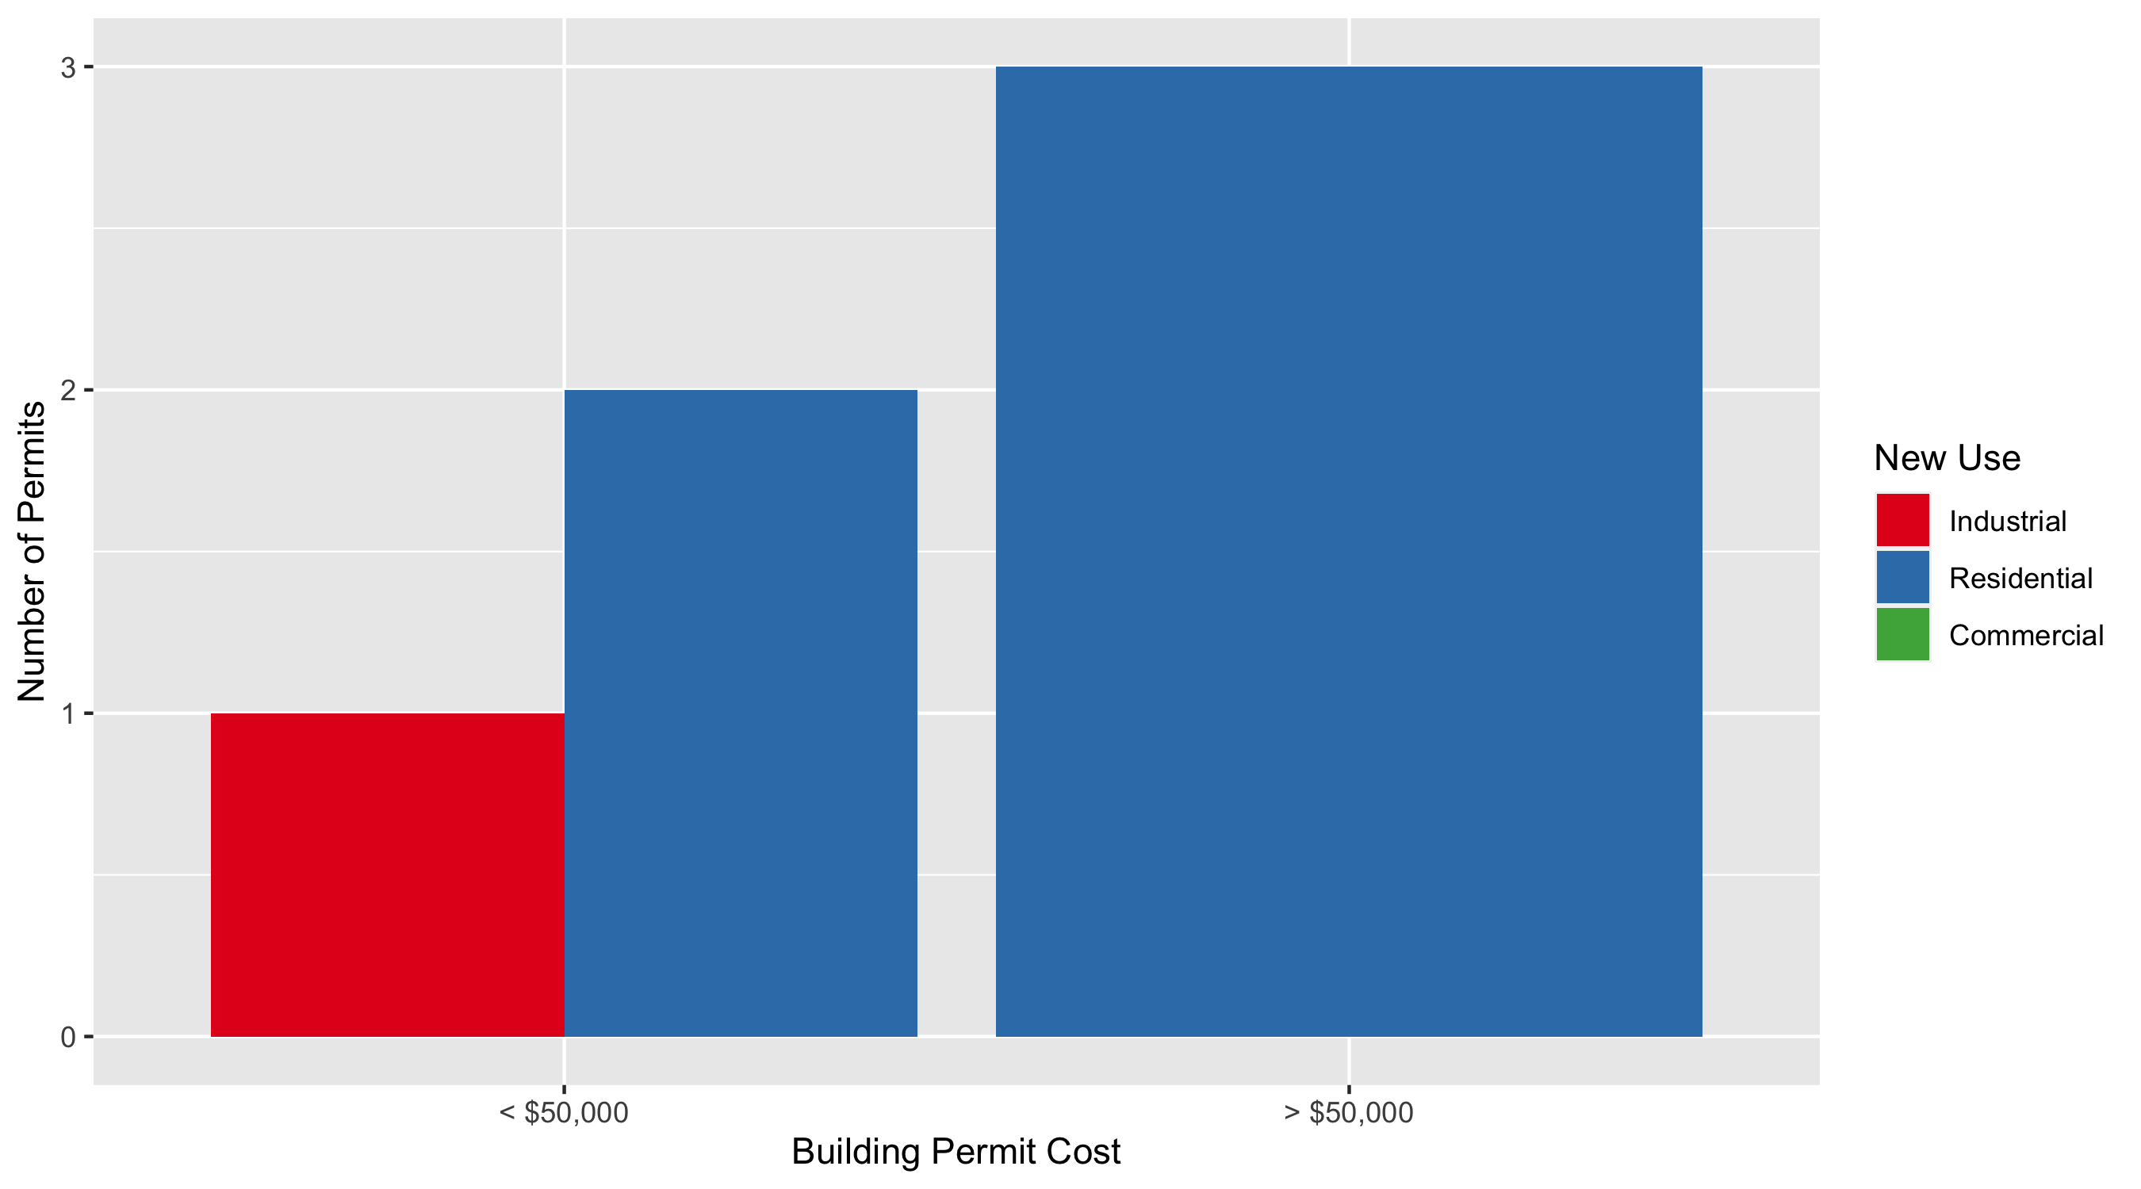
DeBaliviere Place Permit Cost Breakdown

Slide 29
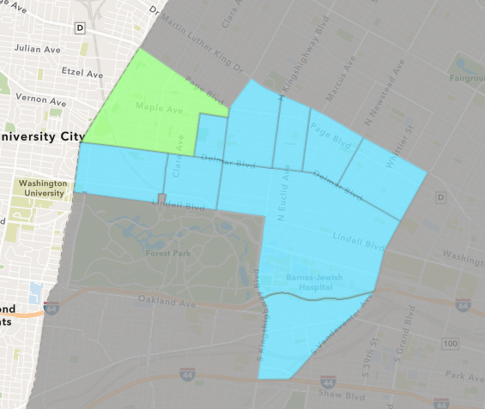
West End
March 2022 Neighborhood Cost Breakdown
Mean: $24,634
Median: $27,950
Range: $6,500 - $37,636

Slide 30
West End: Summary Notes
8 building permits in March 2022
33.33% change compared to March 2021 (6 total building permits)
$24,634: Average building permit cost in March 2022
-77.76% change compared to March 2021 ($110,776)
48 total building permits in 2022
100.00% change YTD compared to this time in 2021 (24 total building permits)
$159,614: YTD average building permit cost in 2022
48.11% change YTD compared to this time in 2021 ($107,766)

Slide 31
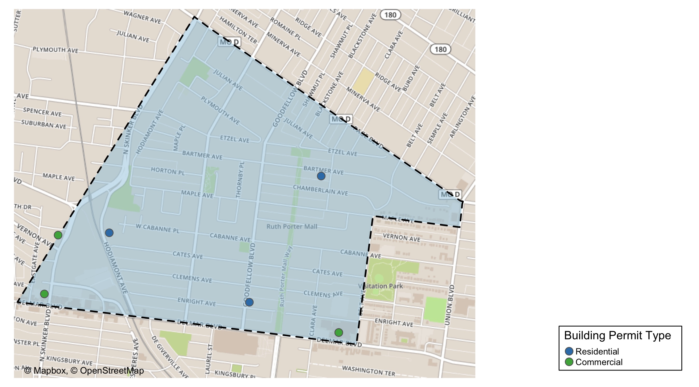
West End

Slide 32
Neighborhood Summary
March 2022 | March 2022 | March 2022 | March 2022
Permit Use | Average Cost | # of Permits | Total Value of Permits
Commercial | $20,358 | 4 | $81,432
Industrial | $0 | 0 | $0
Residential | $28,909 | 4 | $115,636
Last 6 Months | Last 6 Months | Last 6 Months | Last 6 Months
Permit Use | Average Cost | # of Permits | Total Value of Permits
Commercial | $49,565.72 | 43 | $2,131,326
Industrial | $21,198.00 | 1 | $21,198
Residential | $131,192.94 | 50 | $6,559,647

Slide 33
West End Individual Permit Breakdown
Neighborhood | Owner | New Use | Cost | address
West End | DELMAR DIVINE MASTER LANDLORD | Residential | $30,000 | 5501-35 DELMAR BLVD
West End | DELMAR DIVINE CONDO | Commercial | $14,192 | 5535 DELMAR BLVD
West End | MAYHEW, CHARLES E | Residential | $37,636 | 5745 ENRIGHT AV
West End | DELMAR DIVINE CONDO | Commercial | $32,840 | 5501 DELMAR BLVD
West End | COOPER, MANTON L | Residential | $28,000 | 5616 BARTMER AV
West End | GENXMEX REAL ESTATE HOLDING CO LLC | Commercial | $6,500 | 851 N SKINKER BLVD
West End | PACE-DELMAR ASSOCIATES LLC | Commercial | $27,900 | 621 N SKINKER BLVD
West End | TRELAWNEY PROPERTIES LLC | Residential | $20,000 | 876 HODIAMONT AV

Slide 34
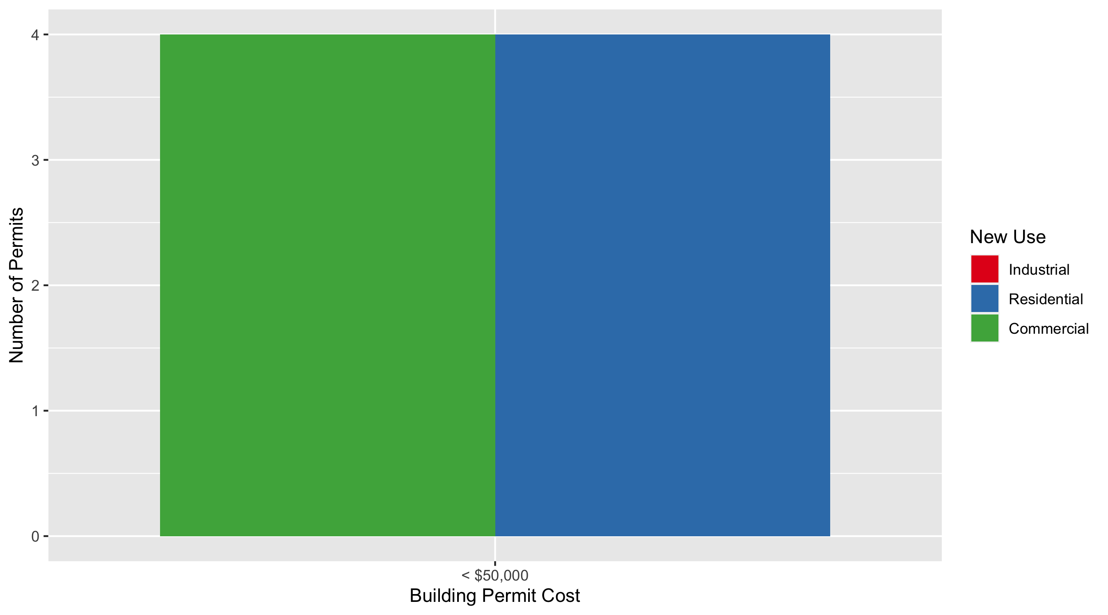
West End Permit Cost Breakdown

Slide 35
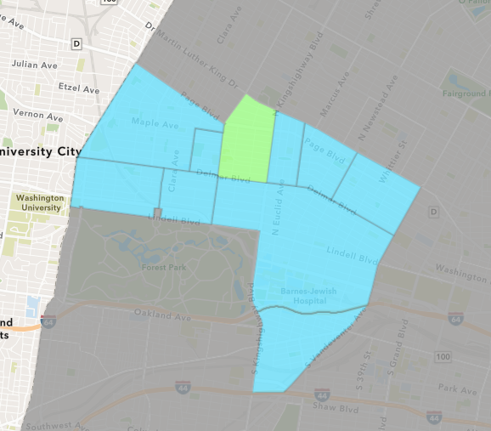
Academy
March 2022 Neighborhood Cost Breakdown
Mean: $4,833
Median: $2,500
Range: $2,000 - $10,000

Slide 36
Academy: Summary Notes
3 building permits in March 2022
200.00% change compared to March 2021 (1 total building permits)
$4,833: Average building permit cost in March 2022
866.67% change compared to March 2021 ($500)
5 total building permits in 2022
0.00% change YTD compared to this time in 2021 (5 total building permits)
$65,740: YTD average building permit cost in 2022
49.97% change YTD compared to this time in 2021 ($43,835)

Slide 37
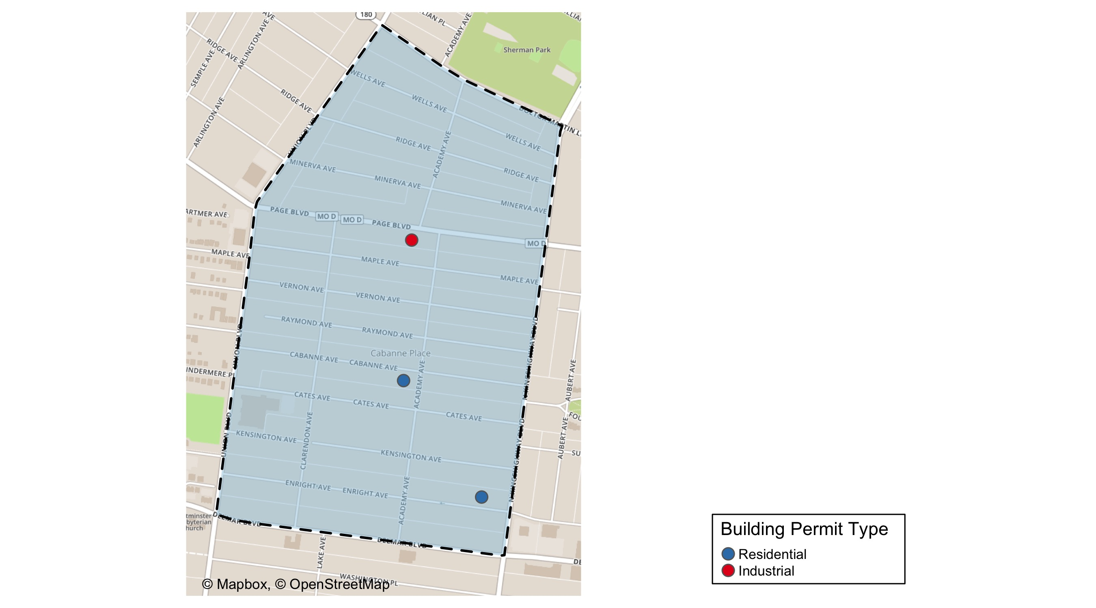
Academy

Slide 38
Neighborhood Summary
March 2022 | March 2022 | March 2022 | March 2022
Permit Use | Average Cost | # of Permits | Total Value of Permits
Commercial | $0 | 0 | $0
Industrial | $2,000 | 1 | $2,000
Residential | $6,250 | 2 | $12,500
Last 6 Months | Last 6 Months | Last 6 Months | Last 6 Months
Permit Use | Average Cost | # of Permits | Total Value of Permits
Commercial | $128,950.000 | 4 | $515,800
Industrial | $1,416.667 | 3 | $4,250
Residential | $29,587.412 | 17 | $502,986

Slide 39
Academy Individual Permit Breakdown
Neighborhood | Owner | New Use | Cost | address
Academy | ELLIS, ETHEL MAE | Industrial | $2,000 | 5122 PAGE BLVD
Academy | WALTERMAN PROPERTIES LLC | Residential | $2,500 | 5112 CABANNE AV
Academy | LYNELL & KHADIJAH WILLS | Residential | $10,000 | 5025 ENRIGHT AV

Slide 40
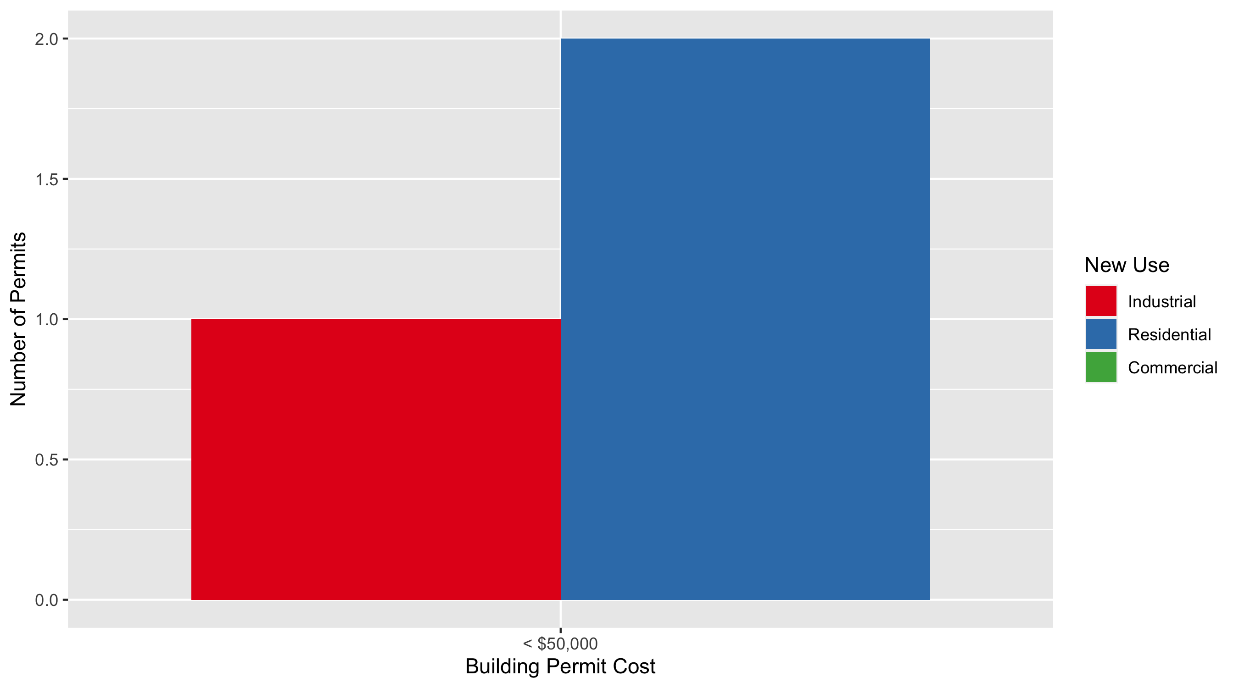
Academy Permit Cost Breakdown

Slide 41
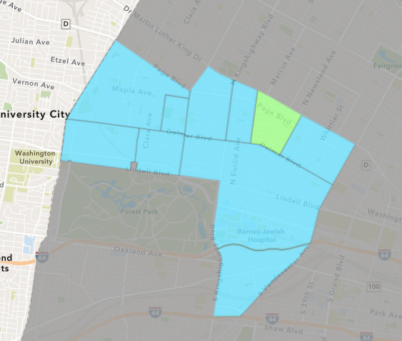
Lewis Place
March 2022 Neighborhood Cost Breakdown
Mean: $160,510
Median: $160,510
Range: $20,000 - $301,019

Slide 42
Lewis Place: Summary Notes
2 building permits in March 2022
100.00% change compared to March 2021 (1 total building permits)
$160,510: Average building permit cost in March 2022
15950.95% change compared to March 2021 ($1,000)
4 total building permits in 2022
0.00% change YTD compared to this time in 2021 (4 total building permits)
$83,255: YTD average building permit cost in 2022
455.74% change YTD compared to this time in 2021 ($14,981)

Slide 43
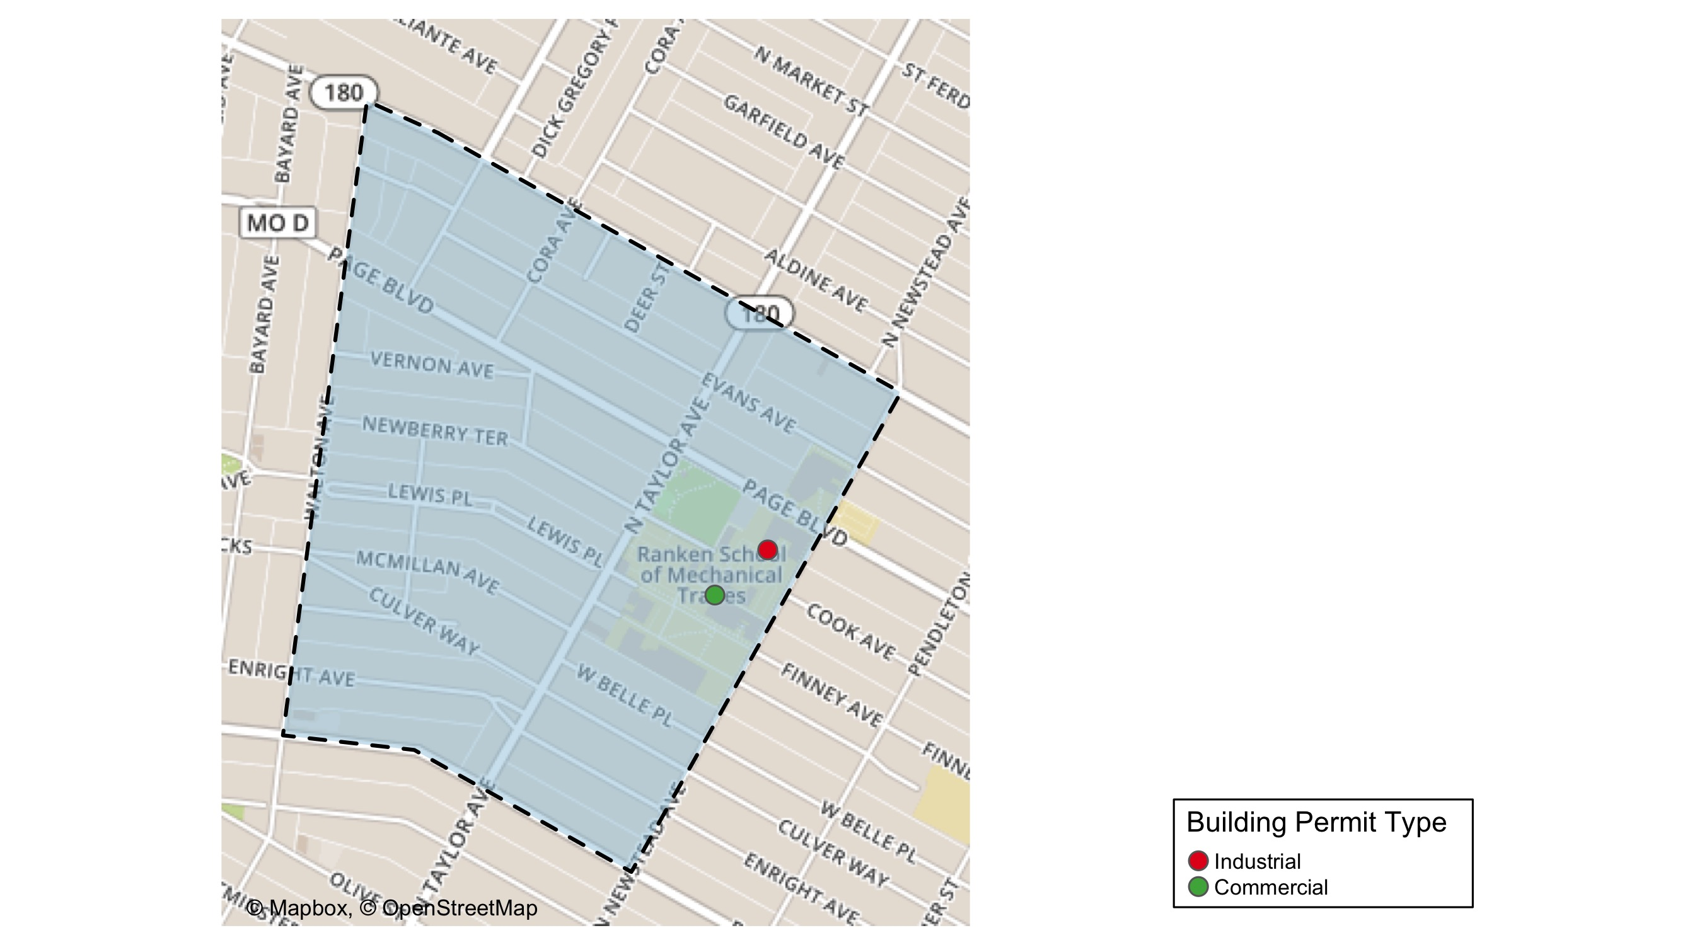
Lewis Place

Slide 44
Neighborhood Summary
March 2022 | March 2022 | March 2022 | March 2022
Permit Use | Average Cost | # of Permits | Total Value of Permits
Commercial | $301,019 | 1 | $301,019
Industrial | $20,000 | 1 | $20,000
Residential | $0 | 0 | $0
Last 6 Months | Last 6 Months | Last 6 Months | Last 6 Months
Permit Use | Average Cost | # of Permits | Total Value of Permits
Commercial | $154,009.5 | 2 | $308,019
Industrial | $8,000.0 | 3 | $24,000
Residential | $32,112.5 | 8 | $256,900

Slide 45
Lewis Place Individual Permit Breakdown
Neighborhood | Owner | New Use | Cost | address
Lewis Place | RANKEN TECHNICAL COLLEGE | Industrial | $20,000 | 4407 COOK AV
Lewis Place | DAVID RANKIN JR SCHOOL P | Commercial | $301,019 | 4431 FINNEY AV

Slide 46
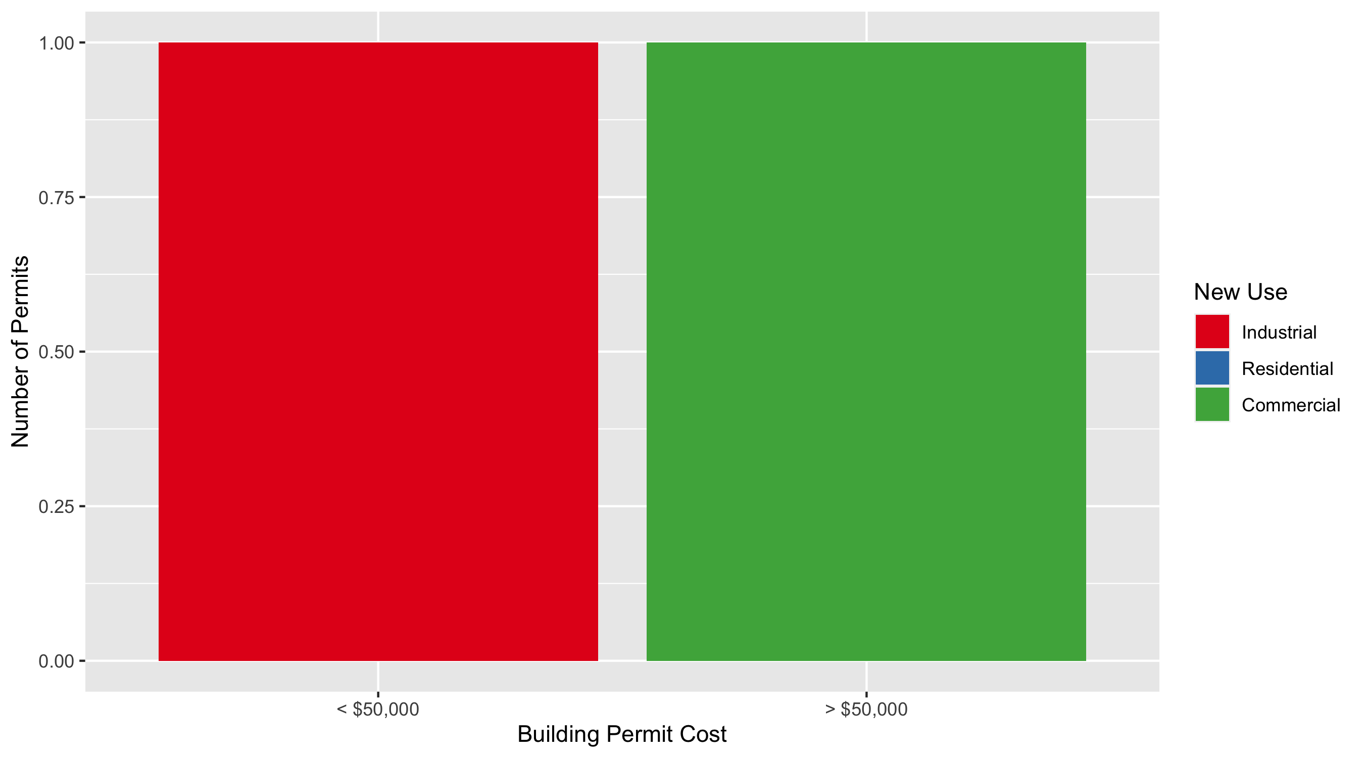
Lewis Place Permit Cost Breakdown

Slide 47
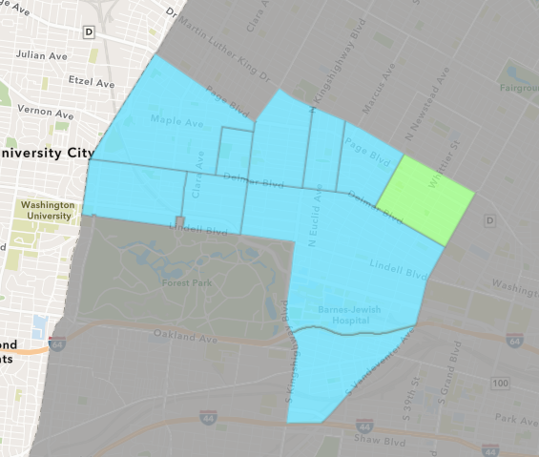
Vandeventer
March 2022 Neighborhood Cost Breakdown
Mean: $30,000
Median: $30,000
Range: $30,000 - $30,000

Slide 48
Vandeventer: Summary Notes
1 building permits in March 2022
Infinite change compared to March 2021 (0 total building permits)
$30,000: Average building permit cost in March 2022
Infinite change compared to March 2021 ($0)
5 total building permits in 2022
Infinite change YTD compared to this time in 2021 (0 total building permits)
$65,100: YTD average building permit cost in 2022
Infinite change YTD compared to this time in 2021 ($0)

Slide 49
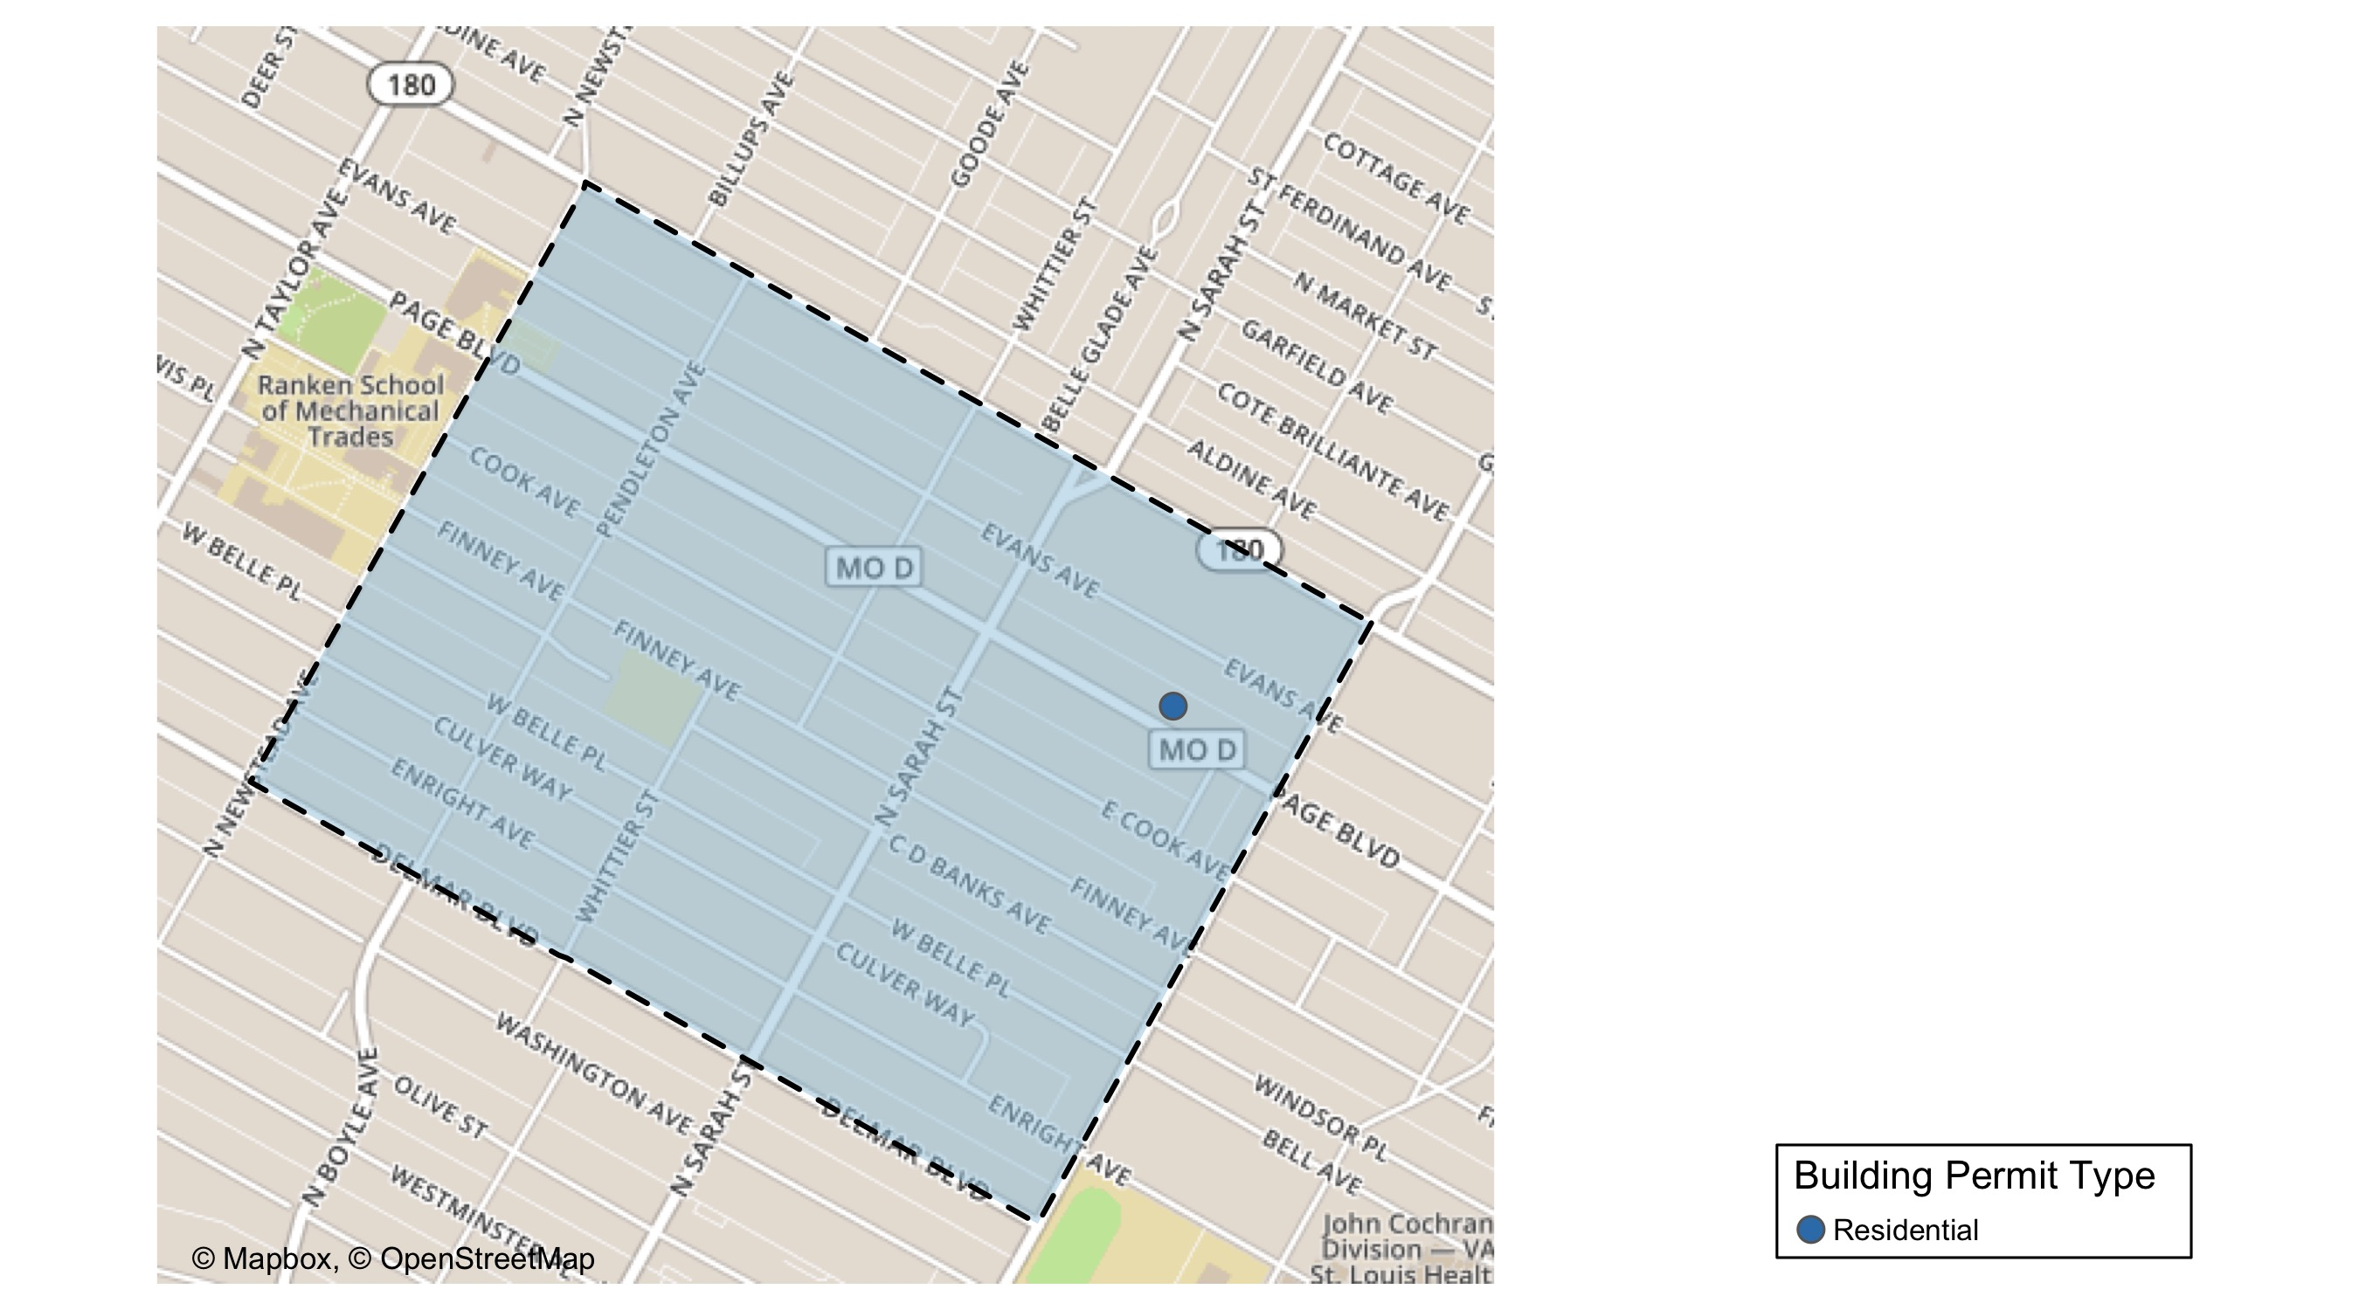
Vandeventer

Slide 50
Neighborhood Summary
March 2022 | March 2022 | March 2022 | March 2022
Permit Use | Average Cost | # of Permits | Total Value of Permits
Commercial | $0 | 0 | $0
Industrial | $0 | 0 | $0
Residential | $30,000 | 1 | $30,000
Last 6 Months | Last 6 Months | Last 6 Months | Last 6 Months
Permit Use | Average Cost | # of Permits | Total Value of Permits
Commercial | $0 | 0 | $0
Industrial | $5,500 | 1 | $5,500
Residential | $636,032 | 14 | $8,904,448

Slide 51
Vandeventer Individual Permit Breakdown
Neighborhood | Owner | New Use | Cost | address
Vandeventer | DPS ENTERPRISES LLC | Residential | $30,000 | 3957-59 PAGE BLVD

Slide 52
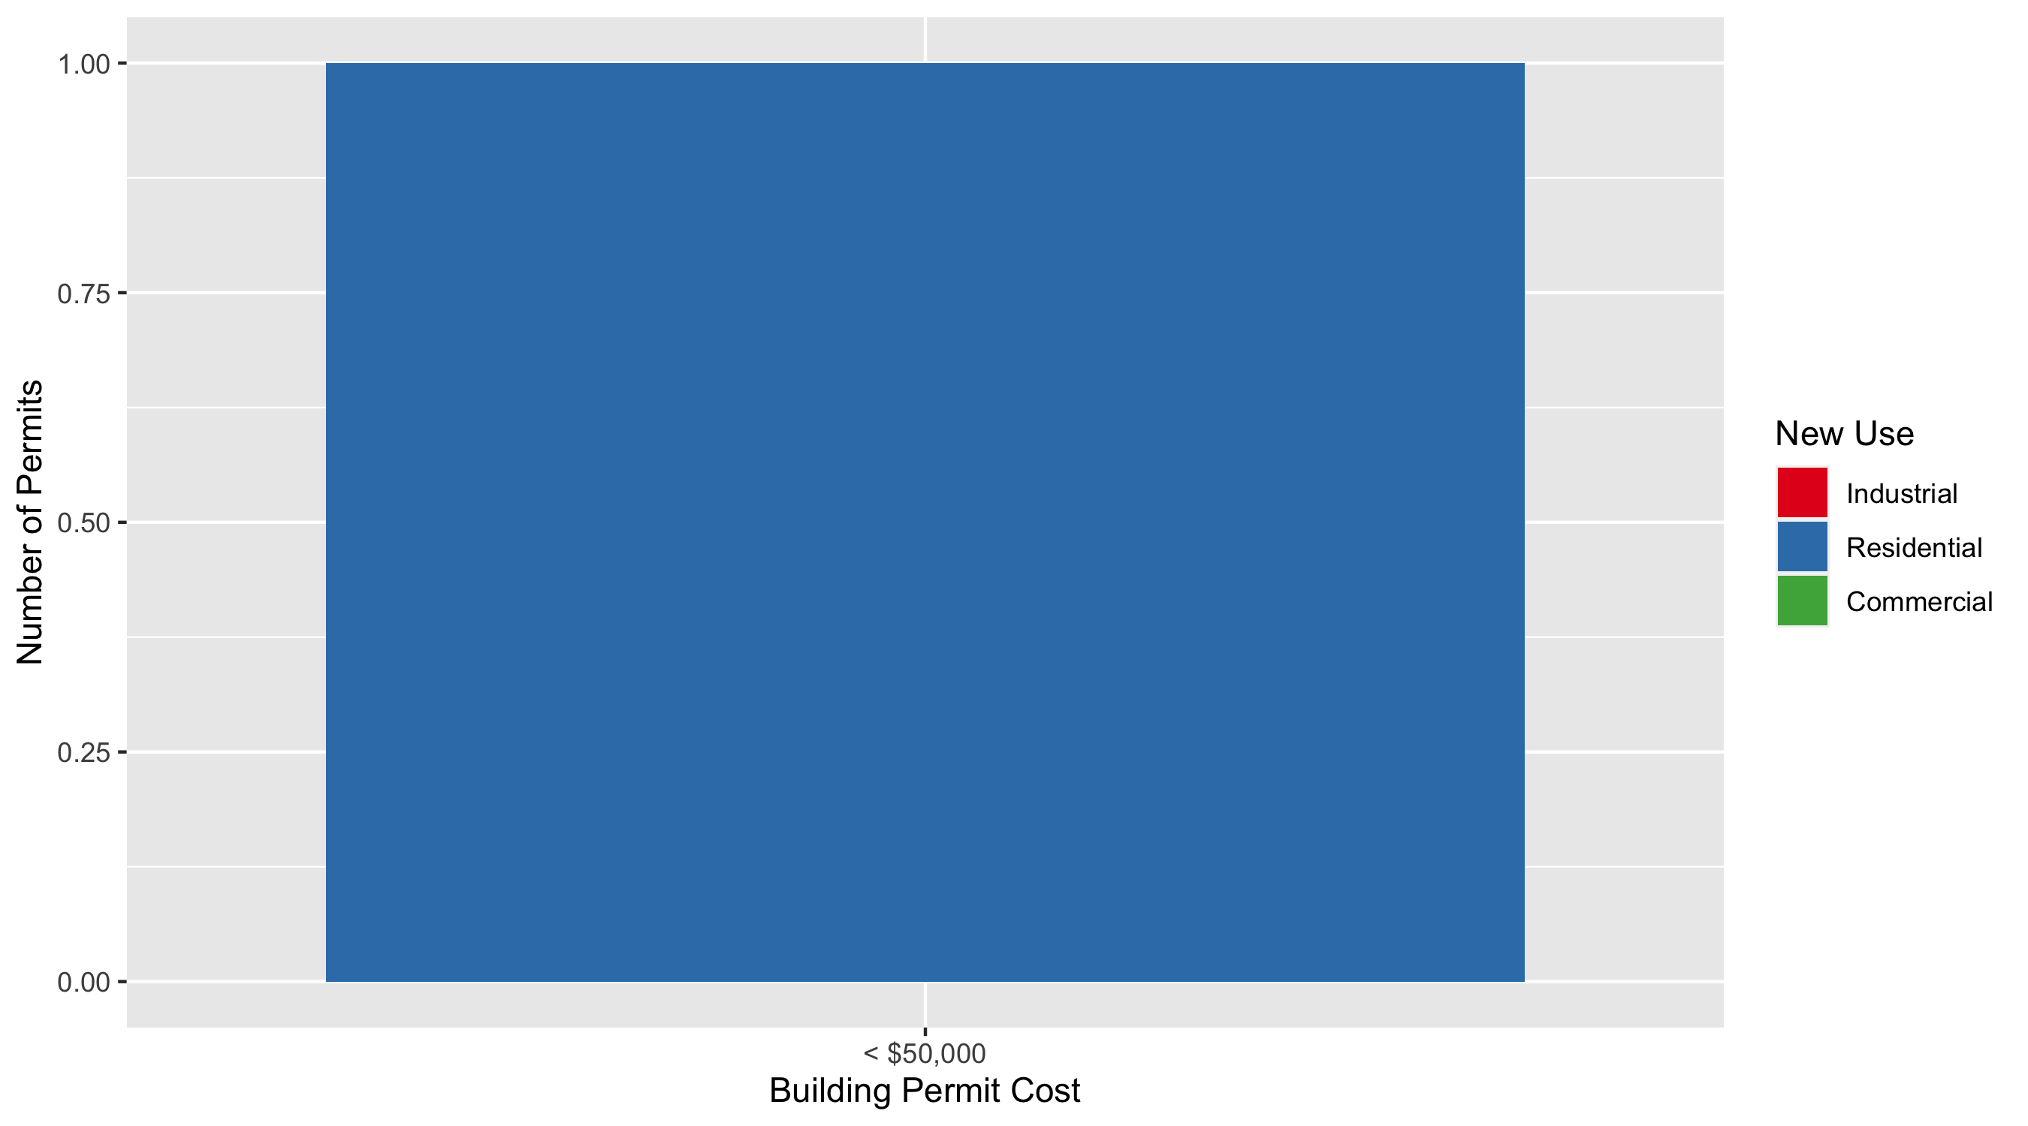
Vandeventer Permit Cost Breakdown

Slide 53
Additional Notes
Data retreived from https://www.stlouis-mo.gov/data/
Building permits with a cost of $0 were dropped
Building permits that were cancelled were dropped
Infinite change indicates 0 permits in the current or previous time period/comparison month so there was a overall increase or decrease

